Slide 1
DevOps, DevSecOps, SRE
Methodologies to success
Ing. Daniel Rajčan
Chief Cloud Architect daniel.rajcan@unicorn.com
Ing. Filip Janovič, PhD., MBA
Cloud / DevOps Architect filip.janovic@unicorn.com

Slide 2
Agenda
What is DevOps?
How DevOps Works?
Benefits of DevOps
DevOps Practices
DevOps Team
What Is SRE?
Benefits of SRE
DevOps vs SRE
Facts About Technologies

Slide 3
What is DevOps?

Slide 4
What is DevOps?
,,DevOps is the combination of cultural philosophies, practices, and tools that increases an organization’s ability to deliver applications and services at high velocity: evolving and improving products at a faster pace than organizations using traditional software development and infrastructure management processes.’’

Slide 5
What is NOT DevOps?
,,DevOps is NOT a technology or set of technologies!’’

Slide 6
How DevOps Works?

Slide 7
Principles
Under a DevOps model, development and operations teams are no longer “siloed”,
Sometimes, these two teams are merged into a single team where the engineers work across the entire application,
In some DevOps models, quality assurance and security teams may also become more tightly integrated with development and operations and throughout the application lifecycle,
When security is the focus of everyone on a DevOps team, this is sometimes referred to as DevSecOps,

Slide 8
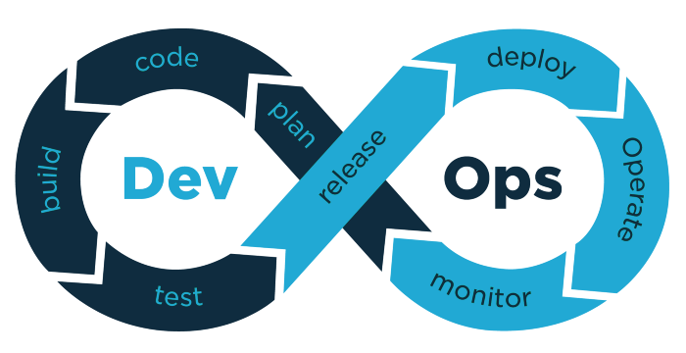
DevOps Loop

Slide 9
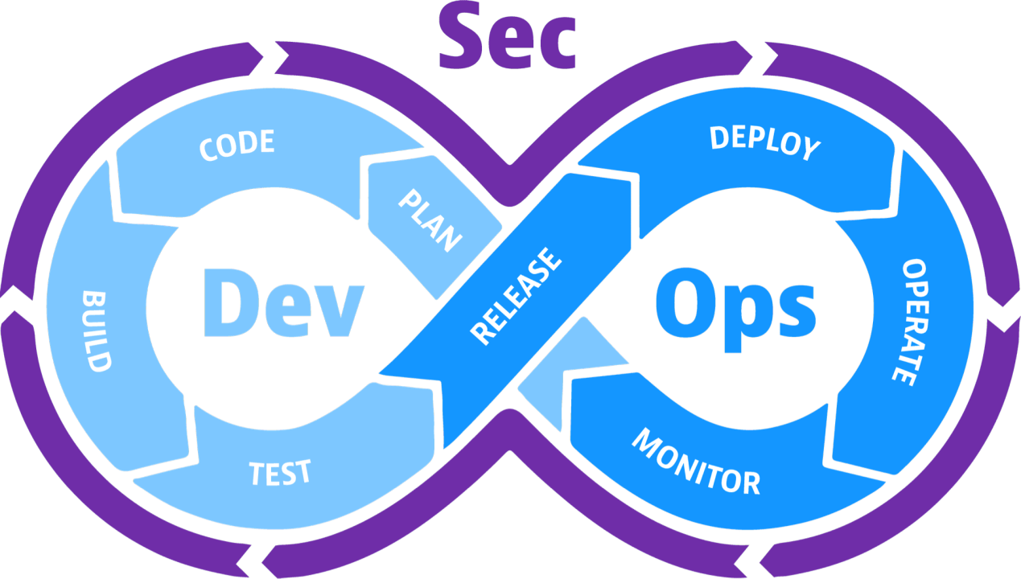
DevSecOps Loop

Slide 10
Principles
These teams use practices to automate processes that historically have been manual and slow,
They use a technology stack and tooling which help them operate and evolve applications quickly and reliably,
These tools also help engineers independently accomplish tasks (for example, deploying code or provisioning infrastructure) that normally would have required help from other teams, and this further increases a team’s velocity.

Slide 11
Benefits of DevOps

Slide 12
Benefits of DevOps
Improved Collaboration - Build more effective teams under a DevOps cultural model, which emphasizes values such as ownership and accountability. Developers and operations teams collaborate closely, share many responsibilities, and combine their workflows.
Speed - Move at high velocity so you can innovate for customers faster, adapt to changing markets better, and grow more efficient at driving business results,
Rapid delivery - Increase the frequency and pace of releases so you can innovate and improve your product faster,

Slide 13
Benefits of DevOps
Reliability - Ensure the quality of application updates and infrastructure changes so you can reliably deliver at a more rapid pace while maintaining a positive experience for end users,
Scale - Operate and manage your infrastructure and development processes at scale. Automation and consistency help you manage complex or changing systems efficiently and with reduced risk,
Security - Move quickly while retaining control and preserving compliance.

Slide 14
DevOps Practices

Slide 15
DevOps Practices
Communication and Collaboration - Increased communication and collaboration in an organization is one of the key cultural aspects of DevOps,
Continuous Integration - Is a software development practice where developers regularly merge their code changes into a central repository, after which automated builds and tests are run,
Continuous Delivery - Is a software development practice where code changes are automatically built, tested, and prepared for a release to production,

Slide 16
DevOps Practices
Microservices - The microservices architecture is a design approach to build a single application as a set of small services,
Infrastructure as Code - Is a practice in which infrastructure is provisioned and managed using code and software development techniques, such as version control and continuous integration,
Monitoring and Logging (Observability) - By capturing, categorizing, and then analyzing data and logs generated by applications and infrastructure, organizations understand how changes or updates impact users, shedding insights into the root causes of problems or unexpected changes.

Slide 17
DevOps Team

Slide 18
DevOps Team Structure
Team Leader,
Developers,
Testers,
Administrators,
Architects,
Security Engineers,
Managers, …
,,DevOps team structure is not strictly defined. Its size and structure depends on company/project size and requirements.’’

Slide 19
DevOps Team Responsibilities
Communication and Cooperation
Architecture and design,
Process automation,
CI/CD pipelines,
Infrastructure as Code,
Adoption of new technologies,
Security Compliance,
Observability,
Studying, …
,,DevOps Team is responsible for whole project/application lifecycle.’’

Slide 20
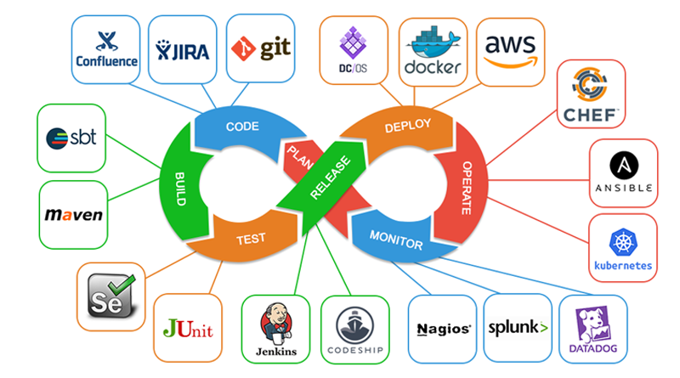
Example of DevOps tool chain

Slide 21
What is SRE?
Copyright © Unicorn Systems a.s.

Slide 22
What is SRE?
,,Site Reliability Engineering (SRE) is responsible for implementing the product developed by the Core Development team. The key objective of the SREs is to implement and automate DevOps practices to reduce the level of incidents and improve reliability and scalability. SREs are also responsible for sending swift and constant feedback to the Development team based on performance metrics – availability, latency, efficiency, capacity, and incident.’’

Slide 23
Benefits of SRE
Copyright © Unicorn Systems a.s.

Slide 24
Benefits of SRE
Reduced Mean Time to Recovery (MTTR) - In the event of a bug or production failure, SRE teams can roll back to the previous stable version of a product so that Mean Time to Recovery (MTTR) is reduced,
Reduced Mean Time to Detect (MTTD) - Canary rollouts help the SRE team find the issues in the early stage with a limited number of affected users,
Automated Everything - Automation is one of the biggest challenges the SRE team has to face,

Slide 25
Benefits of SRE
Automated Functional and Non Functional Testing in Production - Reliability engineers can help implement automation testing on Production environments without affecting the end-user,
On-Calls and Incident Documentation - The SRE team can build up a valuable knowledge base on incidents to improve the incident troubleshooting time,
Shared Knowledge - Regular knowledge base updates by SREs in collaboration with DevOps can fill the knowledge gap between the teams.

Slide 26
DevOps vs SRE
Copyright © Unicorn Systems a.s.

Slide 27
Differences between DevOps and SRE
Implementing New Features - DevOps is responsible for implementing the new features request to a product, whereas SREs ensure those new changes don’t increase the overall failure rates in production,
Process Flow - A DevOps team has a perspective of the development environment to put changes from development to production. On the other hand, SREs have a perspective of production, so they can make suggestions to the development team to limit the failure rates despite the new changes,

Slide 28
Differences between DevOps and SRE
Focus – DevOps’s primary focus is on continuity and speed of product development, whereas SRE’s main focus is on the system’s reliability, scalability, and availability,
Team Structure – A typical DevOps team consists of professionals with dedicated roles and responsibilities such as – Product Owner, Team Lead, Cloud Architect, Software Developer, QA Engineer, Release Manager, System Administrator. In contrast, SREs have a team of engineers with operational and development skills set.

Slide 29
Differences between DevOps and SRE
While the two share some core values, the focus of their work is different – the application lifecycle through DevOps and operations lifecycle management through SRE,
They are both working towards the same goal – enhancing the release cycle and achieving better product reliability.

Slide 30
Facts About Technologies
Copyright © Unicorn Systems a.s.

Slide 31
Facts About Technologies
There is NOT any technology with solves everything,
Every new technology brings new challenges,
Do NOT use complex technologies for simple problems,
There has to be relation between business value and technology improvement,
Choose technology according to your needs and NOT vice versa,
New technology should be applied on existing systems too, NOT only on future systems,

Slide 32
Facts About Technologies
Introducing of new technology should bring some kind of improvement/simplification,
Do NOT implement everything at once,
Implementation of new technology is needed to communicate with team.

Slide 33
Thank you!

